Slide 1
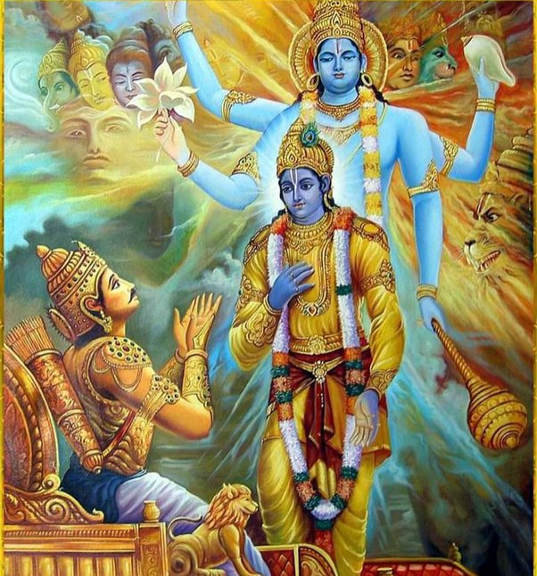
Bhagavad Gita

Slide 2
Introduction
The Bhagavad Gita, spoken by Lord Krishna on the battlefield of Kurukshetra, remains a timeless guide for facing challenges.
In the epic Mahabharata, this war was the largest ever fought on Earth, presenting a scenario of intense fear and anxiety.

Slide 3
The Battlefield of Kurukshetra
Kurukshetra symbolizes the challenges we face in life, both internal and external.
The warriors stood face-to-face, with the only options being to kill or be killed, leading to a state of heightened emotions and a blank mind.

Slide 4
Arjuna's Dilemma
Arjuna, a skilled warrior, faced emotional turmoil and sought guidance.
The magnitude of the war led to a mindset of kill or be killed, causing fear and anxiety.

Slide 5
Speaking in Crisis
Speaking and guiding in such a critical environment requires super courage, conviction, a cool mind, and a calm heart.
Only a divine being like Lord Krishna could provide guidance under such circumstances.

Slide 6
Arjuna's Courage
Arjuna displayed exceptional courage by expressing his feelings, asking questions, and listening to Lord Krishna despite his emotional turmoil.

Slide 7
Wisdom from Lord Krishna
Lord Krishna's responses to Arjuna's questions are pearls of wisdom.
The Bhagavad Gita transcends time and serves as a scripture guiding individuals even in the modern world.

Slide 8
Facing Unfavorable Circumstances
Life will present unfavorable circumstances, making us thoughtless, speechless, and actionless.
The key is to control emotions, pray, and gather courage to navigate through challenges.

Slide 9
Seeking Help
Arjuna sought help from Lord Krishna, emphasizing the importance of seeking guidance from mentors, Gurus, or trusted friends.
Never be afraid to ask for help in a crisis.

Slide 10
Surrender and Faith
Complete surrender to the Guru is essential for receiving guidance.
Accept the advice unconditionally and act without doubt or hesitation.

Slide 11
Transforming from Victim to Victor
Lord Krishna's teachings transformed Arjuna from a state of confusion to clarity.
Apply the guidance received to turn from a victim to a victor, from a loser to a winner.

Slide 12
Fighting Your Own Battle
Lord Krishna advised and directed Arjuna but did not fight for him.
Similarly, in life, individuals must face their battles using the wisdom and guidance received.

Slide 13
Conclusion
The Bhagavad Gita teaches us to face challenges with courage, seek guidance, and transform adversity into victory.
Embrace the timeless wisdom for a purposeful and fulfilled life.

